Slide 1
Stick to the Script
Terminal 101 Day 3

Slide 2

Class Objectives
By the end of today’s class, you will be able to:
Discuss three benefits of text processing programs over programming languages for a security professional.
Use sed to make substitutions to a file.
Use awk to isolate data points from a complex log file.
Edit the contents within a file using nano.
Design an IP lookup shell script by passing arguments.
‹#›

Slide 3
Welcome Back to The Terminal

Slide 4
Activity: Terminal Warm-Up
You continue as a security analyst at Wonka Corp.
Thanks to your great work, the authorities have been able to charge Slugworth. The prosecutor has subpoenaed you for a list of additional data to help build their case.
You are tasked with gathering additional information as specified in the subpoena.
10 minutes

Slide 5
‹#›

Slide 6
Terminal Warm-Up
‹#›

Slide 7
Text Processing
‹#›

Slide 8
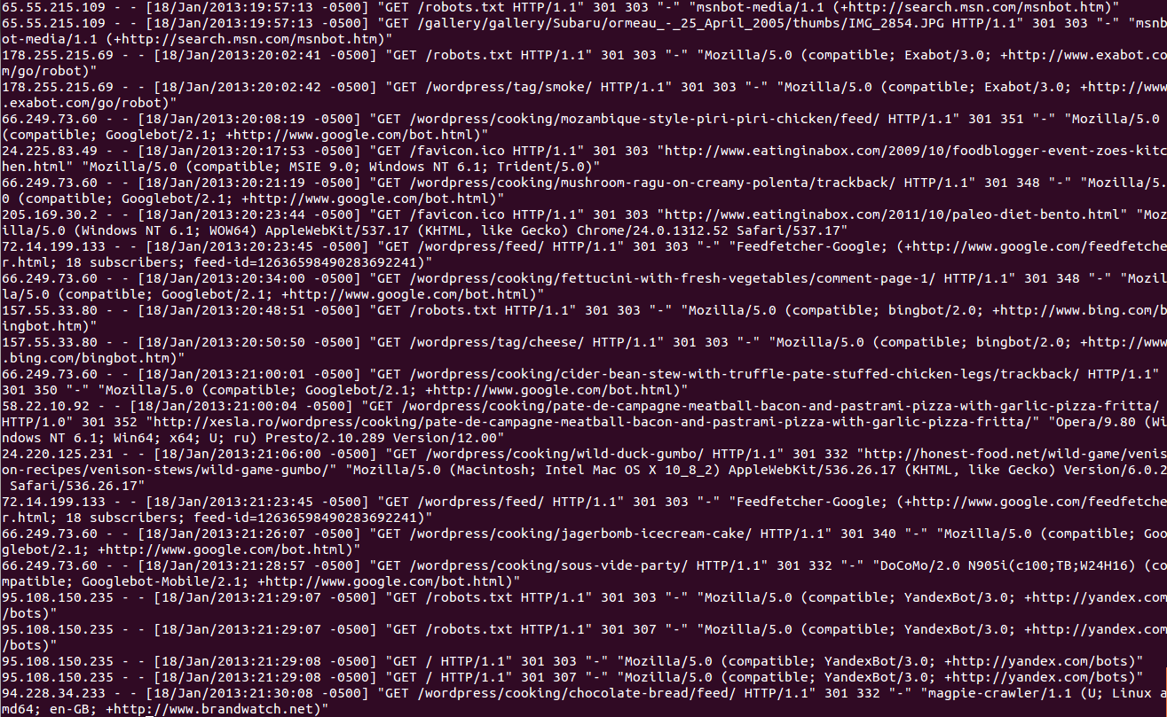
Security professionals work with many forms of data, such as:
Application logs
Server logs
Server files
Configuration files
Raw code
‹#›

Slide 9
Embedded within these large, complex files are data points that help security analysts research security incidents, such as:
Dates
Usernames
Phone numbers
‹#›

Slide 10
We can use this data to:
Isolate attack signatures.
Identify attack vectors.
Identify timing of attacks.
‹#›

Slide 11

Text Processing Commands
‹#›
Notes:
AdobeStock_203402913

Slide 12

Text Processing Commands
We can tackle these dense walls of data with text processing commands.
These command languages manipulate text and simplify complex data by:
Substituting text
Filtering lines of text
Delimiting text
‹#›
Notes:
AdobeStock_242587195

Slide 13
Text Processing Commands
Multiple text processing commands are already built into the terminal, such as:
cut
awk
sed
Other languages can also manipulate text, such as Python and C++.
These are designed for programming and are primarily used to run web applications.
‹#›

Slide 14
Text Processing Commands
Text processing provides the following benefits over programming languages:
Simplicity
Convenience
Compatibility
Text processing is simpler and easier to learn than programming languages.
Most text processing commands are pre-installed in terminals, unlike many programming languages.
Text processing commands can easily be added together to complete more advanced tasks—a complicated task with programming languages.
‹#›

Slide 15
Today we will focus on the powerful
text processing utilities of awk and sed.
‹#›

Slide 16
sed
‹#›

Slide 17

Challenges of Data Processing
One challenge of complex files is the need to consolidate data from two sources.
For example:
A security professional wants to analyze login activities from two different applications.
LOGGED_IN
ACCESS_
ACCEPTED
One application labels logins
The other labels logins
‹#›
Notes:
AdobeStock_170808579

Slide 18

Challenges of Data Processing
You need to replace the string ACCESS_ACCEPTED with LOGGED_IN to make the data consistent and allow for both datasets to be analyzed together.
ACCESS_
ACCEPTED
LOGGED_IN
‹#›
Notes:
AdobeStock_170808579

Slide 19
sed
We can solve this complication by using sed.
sed stands for stream editor.
It reads and edits text, line-by-line from an input stream.
Syntax is: sed s/(old value)/(replacement value)/
It is similar to the familiar find and replace feature in Windows systems.
‹#›

Slide 20


sed
In the next walkthrough, we will complete a simple string replacement using sed.
The Dog Chased the Ball
with
The Dog Chased the Cat
We can use sed to replace
Ball
Cat
with
‹#›
Notes:
Image Sources: AdobeStock_293273817, AdobeStock_293273817

Slide 21
sed
‹#›

Slide 22

Demo Summary
sed s/(old value)/(replacement value)/
sed is a text processing utility that can help security professionals analyze data.
The most basic sed capability is string replacement.
This can help with research by making separate data sources more consistent.
# Remove roots login shell and lock the root account.
usermod -s /sbin/nologin root
usermod -L root
# Print it out and Log it
echo "$(date) Disabled root shell. Root user cannot login." | tee -a $log_file
# Change permissions on sensitive files
chmod 600 /etc/shadow
chmod 600 /etc/gshadow
chmod 644 /etc/group
chmod 644 /etc/passwd
# Print it out and Log it
echo "$(date) Changed permissions on sensitive /etc files." | tee -a $log_file
# Setup scripts folder
if [ ! -d /home/sysadmin/scripts ]
then
mkdir /home/sysadmin/scripts
chown sysadmin:sysadmin /home/sysadmin/scripts
fi
# Add scripts folder to .bashrc for sysadmin
echo "" >> /home/sysadmin/.bashrc
echo "PATH=$PATH:/home/sysadmin/scripts" >> /home/sysadmin/.bashrc
echo "" >> /home/sysadmin/.bashrc
# Print it out and Log it
echo "$(date) Added ~/scripts directory to sysadmin's PATH." | tee -a $log_file
‹#›
Notes:
AdobeStock_135518271

Slide 23
Activity: Using sed
You continue in your role as security analyst at Wonka Corp. Your manager suspects a new cybercriminal is attempting to log in to several administrative websites owned by Wonka. They provided you with the access logs for two different websites.
You must combine the two access logs into a single file and use text processing to make the “failed login” data consistent.
15 Minutes
‹#›

Slide 24
‹#›

Slide 25
Activity Review: Using sed
Completing this activity required the following steps:
Concatenating multiple files into a single file.
Using sed to do a replacement of text.
Redirecting the results into a new file.
‹#›

Slide 26
awk
‹#›

Slide 27
Remember:
We’ll need to obtain specific data points within complex log files.
‹#›

Slide 28

Intro to awk
You have a log record containing city, state, and country fields, separated by commas. But, for our analysis, we only need the state from the log record.
We have:
Atlanta, Georgia, USA
But we only need:
Atlanta, Georgia, USA
‹#›

Slide 29

Intro to awk
We can technically use sed to perform the task:
sed 's/^.*\(,.*,\).*$/\1/' | sed 's/,//g'
sed
This looks (and is) very complicated.
Fortunately, there is a more efficient tool: awk.
awk
‹#›
Notes:
AdobeStock_198817412

Slide 30
Intro to awk
Like sed, awk is designed for text processing, but is particularly useful for data extraction and reporting against streams of text.
awk -F, '{print $(field_number)}'
awk is the indicator to tell your operating system to run the awk command.
‹#›

Slide 31
Intro to awk
Like sed, awk is designed for text processing, but is particularly useful for data extraction and reporting against streams of text.
awk -F, '{print $(field_number)}'
The parameter comes directly after the -F, with no spaces.
-F, is the option for doing field separation with awk.
The next value is the parameter, which signifies what separates the data in the file.
This parameter is also known as the delimiter.
In the example, we used a comma (,).
‹#›

Slide 32
Intro to awk
Like sed, awk is designed for text processing, but is particularly useful for data extraction and reporting against streams of text.
awk -F, '{print $(field_number)}'
{print $2}' indicates awk is printing the second field, after the fields have been separated by the comma.
The $ must be included before the number to indicate the field.
Multiple fields can be added, with a comma between each.
The format requires single quotes (`''`) and curly brackets (`{}`)around the print function.
‹#›

Slide 33

awk Walkthrough
In the next walkthrough, we will isolate the state field from the previous example, using awk.
(Source)
‹#›
Notes:
https://dribbble.com/shots/6581243-Digital-Marketing On Pasteboard: AdobeStock_248243138

Slide 34
Demo Scenario:
awk for a Security Incident
In this demo, we’ll act as security analysts at ACME Corp, which just experienced an attack of a high volume of network requests. You received the logs of these network requests.
You must isolate out the IP addresses and time from these logs to determine which IP address appears most frequently. This IP likely belongs to the attacker.

Slide 35


Introduction to awk
awk for a Security Incident
Instructor Demonstration
‹#›

Slide 36
Demos: Introduction to awk & awk for a Security Incident
You are a security analyst at ACME Corp, which just experienced an attack of a high volume of network requests. You received the logs of these network requests.
You must isolate out the IP addresses and time from these logs to determine which IP address appears most frequently. This IP likely belongs to the attacker.
10 Minutes
‹#›

Slide 37
Demo Review: Introduction to awk & awk for a Security Incident
The previous demo covered the following concepts:
awk is a text processing utility like sed, but more robust. It can separate out fields with simple code.
Security professionals can use awk to isolate specific data points, like IP addresses. This info can help determine what IPs should be blocked.
The basic syntax of field separation with awk is: awk -F(delimiter) '{print $(field_number)}'
‹#›

Slide 38
Activity: Using awk
You continue in the role of security analyst at Wonka Corp. Your manager needs your help finding information on the cybercriminal attempting to log in to administrative websites owned by Wonka.
You must isolate several fields from the log file to help determine the primary username attempting to log in.
15 Minutes
‹#›

Slide 39
Activity Review: Using awk
Completing this activity required the following steps:
Moving a file.
Using the awk command to isolate out certain fields.
Redirecting the results into a new file.
‹#›

Slide 40


‹#›
Notes:
Image source: AdobeStock_56885471

Slide 41
Intro to Shell Scripting
‹#›

Slide 42

Intro to Shell Scripting
IT and security professionals often have to complete security tasks involving multiple subsequent commands.
‹#›
Notes:
Image source: shutterstock_1238032882

Slide 43
Intro to Shell Scripting
For example, an IT professional could be tasked with cleaning up space in a directory. They would need to run the following three commands, in order:
01
cd to navigate to the directory that contains log files.
02
zip to compress the files.
03
mv to move the new zip file into archive folder.
If we script these commands together, they will run, in order, with a single command.
‹#›

Slide 44
Benefits of Scripting
Scripting provides the following benefits to IT and security professionals:
Efficiency
Consistency
Reusability
Running multiple commands with a single script can improve the speed of tasks.
Running multiple commands with a single script can improve the consistency of task results.
Scripts can be provided to other users for reusability, meaning the same tasks can be completed by someone unfamiliar with the individual commands.
‹#›

Slide 45
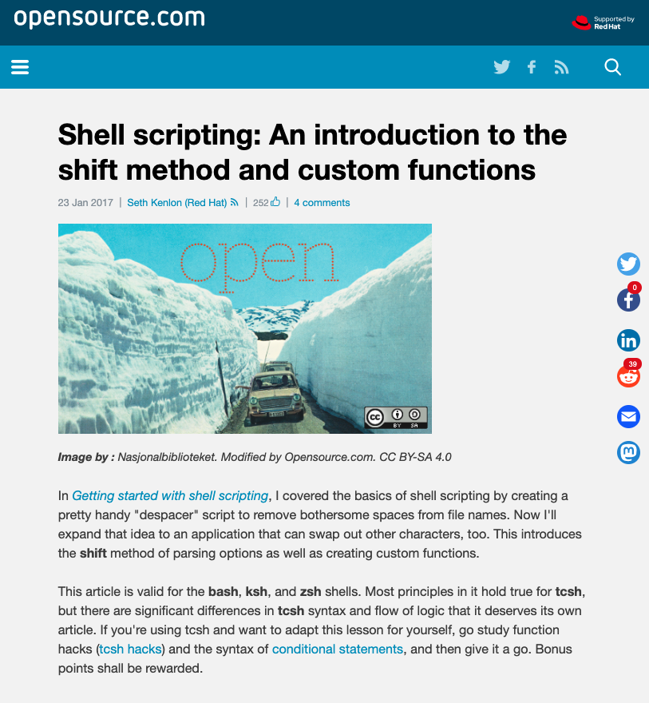

Shell Scripting
We’ll focus on a specific type of scripting known as shell scripting.
Shell is a terminal program that assists in the interaction between user and the terminal.
Several shells are available in the terminal, such as:
Sh
Bash
Zsh
csh
(Opensource.com)
Notes:
AdobeStock_278024683

Slide 46
Shell Scripting
For example, you need to clean up a directory that’s running low on space.
For this scenario, we can use a shell script called diskcleanup.sh. (The extension .sh is required for executable scripts.)
The script includes three commands:
01
cd log_directory
02
zip logs* logfiles.zip
03
mv logfiles.zip ./archive_directory
To execute the script, we run: sh diskcleanup.
‹#›

Slide 47
But wait:
To add these commands to our script, we need to know how to write to a file.
‹#›

Slide 48
Writing and Editing Files
‹#›

Slide 49

Text Editors
Text editors are command-line utilities that edit plain text.
Security professionals can use text editors to build scripts, create documentation, etc.
(Source)
‹#›
Notes:
https://commons.wikimedia.org/wiki/File:Yuieditorbasic.png

Slide 50



Text Editors
You are probably already familiar with text editors.
Notepad on Windows
Text Edit on Mac
‹#›

Slide 51
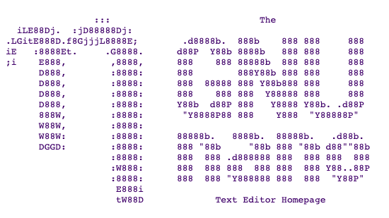



Text Editors
Common text editors available within terminal are: nano, vi, vim, and emacs.
nano
vi
vim
emacs
Today, we’ll focus on nano.
‹#›

Slide 52
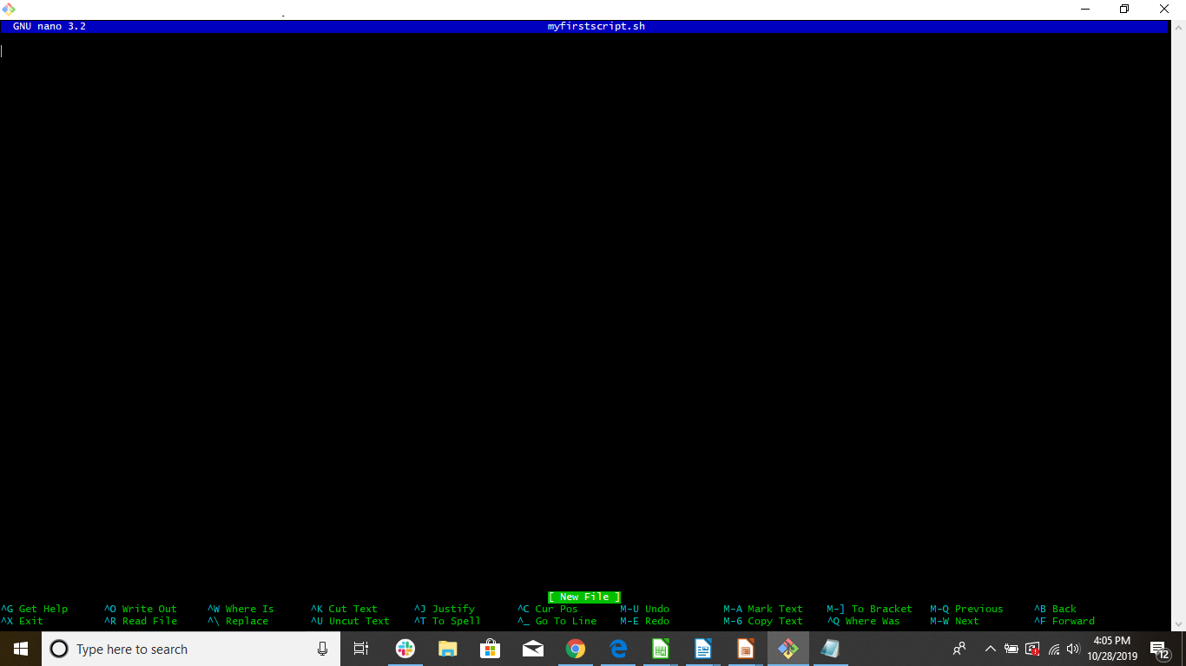
In the next demo, we will use nano to create a simple shell script that contains the two following commands:
mkdir new_directory
cd new_directory

Slide 53
My First Shell Script Review
‹#›

Slide 54
Activity: My First Shell Script
You continue in your role as security analyst at Wonka. Your manager needs help creating a simple shell script to automate the awk and sed tasks you did today on your log file. This shell script will be provided to other security analysts so they can easily complete the same tasks.
You are tasked with using nano to create a shell script with the awk and sed commands to analyze a log file.
15 Minutes
‹#›

Slide 55
‹#›

Slide 56
Activity Review: My First Shell Script
Completing this activity required the following steps:
Use nano to create a shell script.
Place the previously written sed and awk commands inside the shell script .
Execute the shell script to confirm the results work as expected.
‹#›

Slide 57
Passing Arguments
‹#›

Slide 58
Passing Arguments
Sometimes we’ll need to change only a single value in a script.
For example:
A security analyst may need to run the cleanup shell script, but only need it to zip up a certain date.
We need to zip up files named
We need change one command in the script:
logs0519
From
zip logs* logfiles.zip
to
zip logs0519 logfiles.zip
Rather than manually editing the script each time it’s run, we can add passing arguments.

Slide 59
Passing a Single Argument
When a script is run, you can add an argument by placing it after the script name.
For the previous example:
We could run:
The syntax is:
sh diskcleanup.sh 0519
sh shellscript Argument1

Slide 60
Passing a Single Argument
To pass the 0519 into the script, we have to add a $1 indicating where the first argument, 0519 , will be passed.
We change:
zip logs* logfiles.zip
to
zip logs$1 logfiles.zip
When the script is run, the command will be changed:
will run
sh diskcleanup.sh 0519
zip logs0519 logfiles.zip

Slide 61
Adding Multiple Arguments
Additional arguments can be added with the following syntax:
sh shellscript Argument1 Argument2 Argument3
For example:
sh sh diskcleanup.sh 0519 backupfolder
Within the script, the arguments are represented by:
Argument 1 =
$1
Argument 2 =
$2

Slide 62
Activity: Building an IP Lookup Tool
In this activity, you continue in the role of security analyst at Wonka. Your manager needs to know where attacks are coming from so they can block the country from accessing their network.
Your manager is impressed with the great work you did on the last script and asked you to design a script to identify the countries of IP addresses found in the logs.
20 Minutes
‹#›

Slide 63
‹#›

Slide 64
Activity Review: Building an IP Lookup Tool
Completing this activity required the following steps:
Using man to learn a new command.
Using grep, pipes, and awk to modify a terminal command.
Designing a shell script to include the modified command.
Configuring the shell script to accept arguments.
Running the shell script by passing in arguments.

Slide 65
Class Objectives
By the end of today’s class, you will be able to:
Discuss three benefits of text processing programs over programming languages for a security professional.
Use sed to make substitutions to a file.
Use awk to isolate data points from a complex log file.
Edit the contents within a file using nano.
Design an IP lookup shell script by passing arguments.
‹#›

Slide 66
Questions?
‹#›

